Slide 1
GREY WATER MANAGEMENT (GWM)
PIP2001 Capstone Project
Review- 0
Batch Number: G63
Under the Supervision of,
Dr . Prasad P S
Associate Professor
School of Computer Science and Engineering
Presidency University
Roll Number | Student Name
20211CSE0441 | SAHANA R
20211CSE0446 | RADHIKA RELEKAR
20211CSE0696 | SRUSTHI SINGH D T
20211CSE0467 | S FEROZ AHAMED
Name of the Program: B.tech
Name of the HoD: Mohammad Asif T
Name of the Program Project Coordinator: Dr . Sampath A K
Name of the School Project Coordinators: Dr. Sampath A K / Dr. Abdul Khadar A / Mr. Md Ziaur Rahman

Slide 2
Content
Problem Statement
Github Link
Analysis of Problem Statement
Timeline of the Project
References

Slide 3
Problem Statement Number:
Organization: Presidency University
Category (Hardware / Software / Both) : Both
Problem Description: Grey Water Management
Difficulty Level: Complicated

Slide 4
Github Link
The Github link provided should have public access permission.
https://github.com/s1-g/Grey-Water-Management-.git
Github Link

Slide 5
Analysis of Problem Statement
Grey water refers to wastewater from household activities (e.g., sinks, showers, laundry)
that can be treated and reused.
Addressing water contamination and ensuring the sustainability of water resources are
critical.
Without adequate management, its discharge into rivers and lakes leads to water pollution, disrupting aquatic ecosystems and posing health risks
Implementing low-cost treatment solutions can help mitigate these issues, making grey water reusable for non-potable applications such as irrigation, toilet flushing, and groundwater recharge.

Slide 6
Analysis of Problem Statement (contd...)
Software and Hardware Requirements:
Hardware Requirements :
Microcontroller
Water Flow Sensor
Pressure Sensor
Temperature Sensor
Relay Module
Water Pump
Jumper Wires
Breadboard
Software Requirements :
Programming Language: C/C++ (Arduino), Python
Development IDE: Arduino IDE
Data Handling : pandas, numpy (Python)
Machine Learning: scikit-learn
Visualization: matplotlib, seaborn
Data Storage: Google Drive, Google Sheets

Slide 7
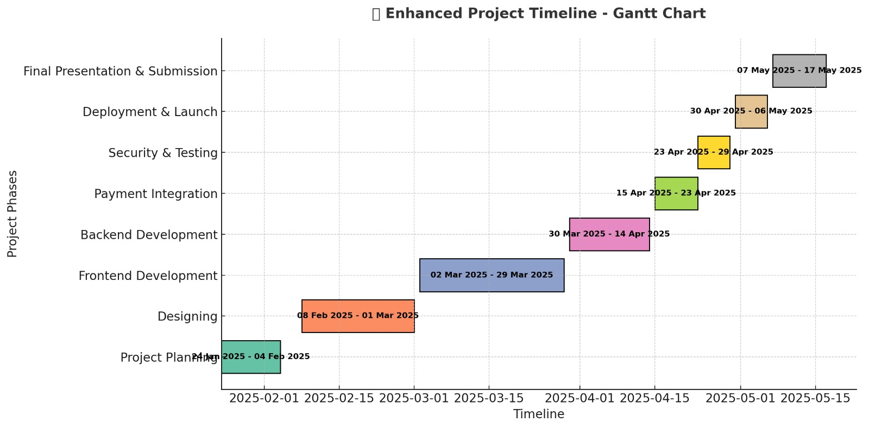
Timeline of the Project (Gantt Chart)

Slide 8
References (IEEE Paper format)
1. A. D. Mande, B. R. Kavathekar, A. S. Langade, N. G. Lasankute, S. H. Patle,(2018), “Low Cost Household Water Treatment Systems: A Review”, International Journal of Engineering Research & Technology (IJERT), ISSN: 2278- 0181,Vol. 7 Issue 03.
2. Indranil Guin, Susheel Kumar Gupta,(2017) “Low Cost Methods of treatment of water for domestic purposes in Rural Areas”, International Journal for Scientific Research & Development, ISSN:2321-0613, Vol. 4, Issue 12.
3. S.Gautam, S.Ahmed, A. Dhingra, Z. Fatima, (2017), “CostEffective Treatment Technology for Small Size Sewage Treatment Plants in India, Journal of Scientific & Industrial Research, vol.76, pp.249-254.
4. EIZein Z, Abdou. A, Abd EL Gawad. I. (2016), “Constructed wetlands as a sustainable waste water treatment method in communities” (2016)pp, ISSN:605-617 ELSEVIER.
5. Karnapa Ajit. (2016) “A Review on Grey Water Treatment and Reuse”, International Research Journal of Engineering and Technology (IRJET) vol:03 Issue:05, may2016.
6. Sameer S Shastri (2014) “Zero Waste Disposal System for Multi-Storied Building.

Slide 9
References (IEEE Paper format)
7. Nargessh Amabadi, Hasan Bakhtiari, Nafise Kochakian, Mahamood Farahani, (2015) “The investigation and designing of an onsite greywater treatment system at Hazrat-e-Masoumeh University”, Qom, (IRAN) ISSN: 1337- 1346.
8. Sandhya Pushkar Singh, Nusrat Ali, Sabih Ahmad, Dr. J.K. Singh, Manoj Kumar,(2015), “A Study on Grey Water Treatment Processes: A Review”, International Journal for Scientific Research & Development, ISSN (online): 2321- 0613,Vol. 3, Issue 08.
9. Prof. K.D. Bhuyar, Mr.Amit. R. Lohakare, Mr.Tejas Patil, Mr.Yogesh Ghode, Ms.Sofiya Sayyad, (2015), “Treatment of Water by Membrane BIO Reactor”, International Journal for Scientific Research & Development, ISSN: 2321-0613, Vol. 2, Issue 12.
10. Vijaya V Shegokar et.al.(2015),”Design and Treatability Studies of Low Cost Grey Water Treatment with Respect to Recycle and Reuse in Rural Areas”.(ISSN):2319-7706 Volume 4 number 8 (2015)pp.
11. G.C. Biswas & Mirajul Islam et al. / International Soil and Water Conservation Research 3 (2015)- Assessment of the irrigation feasibility of low-cost filtered municipal waste water for red amaranth (Amaranths tricolor L cv.Surma).
12. Amr M. Abdel-Kader,(2013) “Studying the efficiency of greywater treatment by using rotating biological contactors system”. (2013) pp, ISSN: 89-95.

Slide 10


